Slide 1

An Improved Unascertained Approach to Construction Accident Risk Assessment and Analysis
Presented By
Garakurthi Rohan
17261A05D8
Guide
Gousiya Begum
Assistant Professor

Slide 2
Existing System
In recent construction works several accidents took place like falling from the elevator, using damaged equipment, misuse of sharp objects. Unless an approach is found on how to overcome those accidents, this problem could get worse and many fatal accidents can take place compared to the previous ones. Due to these causes, workers not only lose their loved ones but also get into financial trouble. Due to this reason it has been a major problem for workers.

Slide 3
Objective
The main objective is to find a way in which future construction accidents can be avoided. This can be done by using text mining and Natural Language Processing Techniques on the past dataset and generating graphs on which the accidents are caused and with the help of machine learning algorithms the accidents are analyzed.

Slide 4
Proposed Work
Providing safety to workers at construction site from accidents by analyzing past accident data by using machine learning algorithms such as Decision Tree algorithm, Naïve Bayes Algorithm, KNN algorithm and Support Vector Machine and then text mining technique such as TF-IDF (Term Frequency-Inverse Document Frequency) and natural language text processing can be used to remove special symbols, stop words, stemming in the dataset.

Slide 5
ALGORITHMS USED
KNN algorithm.
Naïve Bayes algorithm.
Logistic regression algorithm.
Decision Tree algorithm.
Support Vector Machine algorithm.

Slide 6
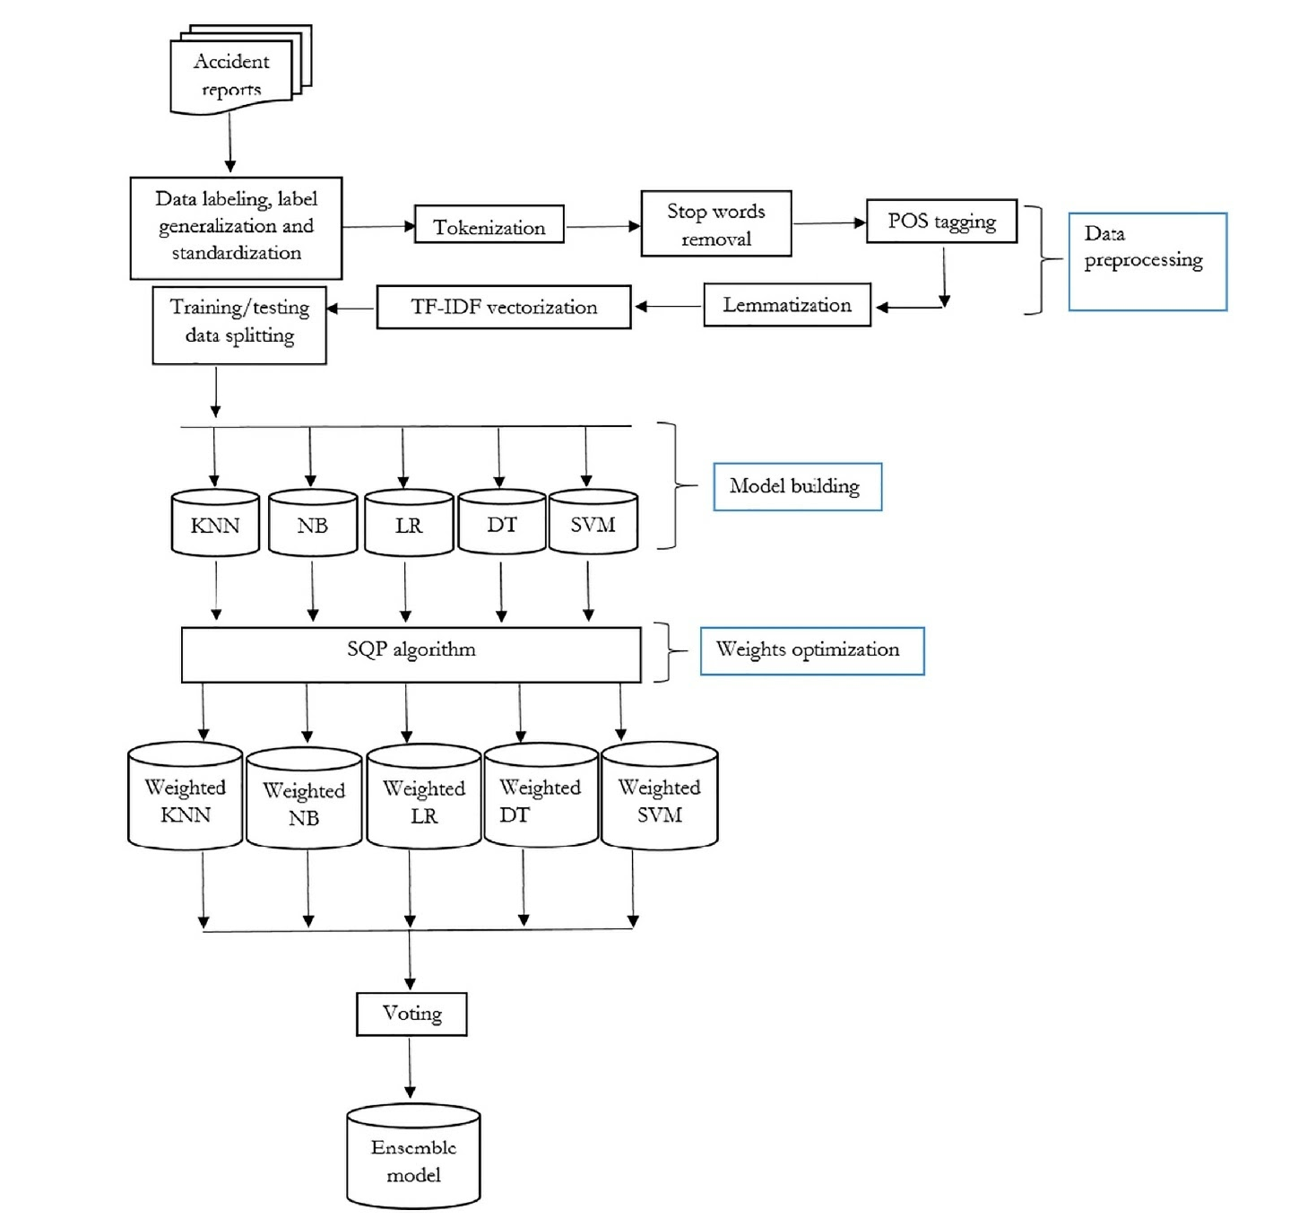
DESIGN METHODOLOGY System Architecture

Slide 7
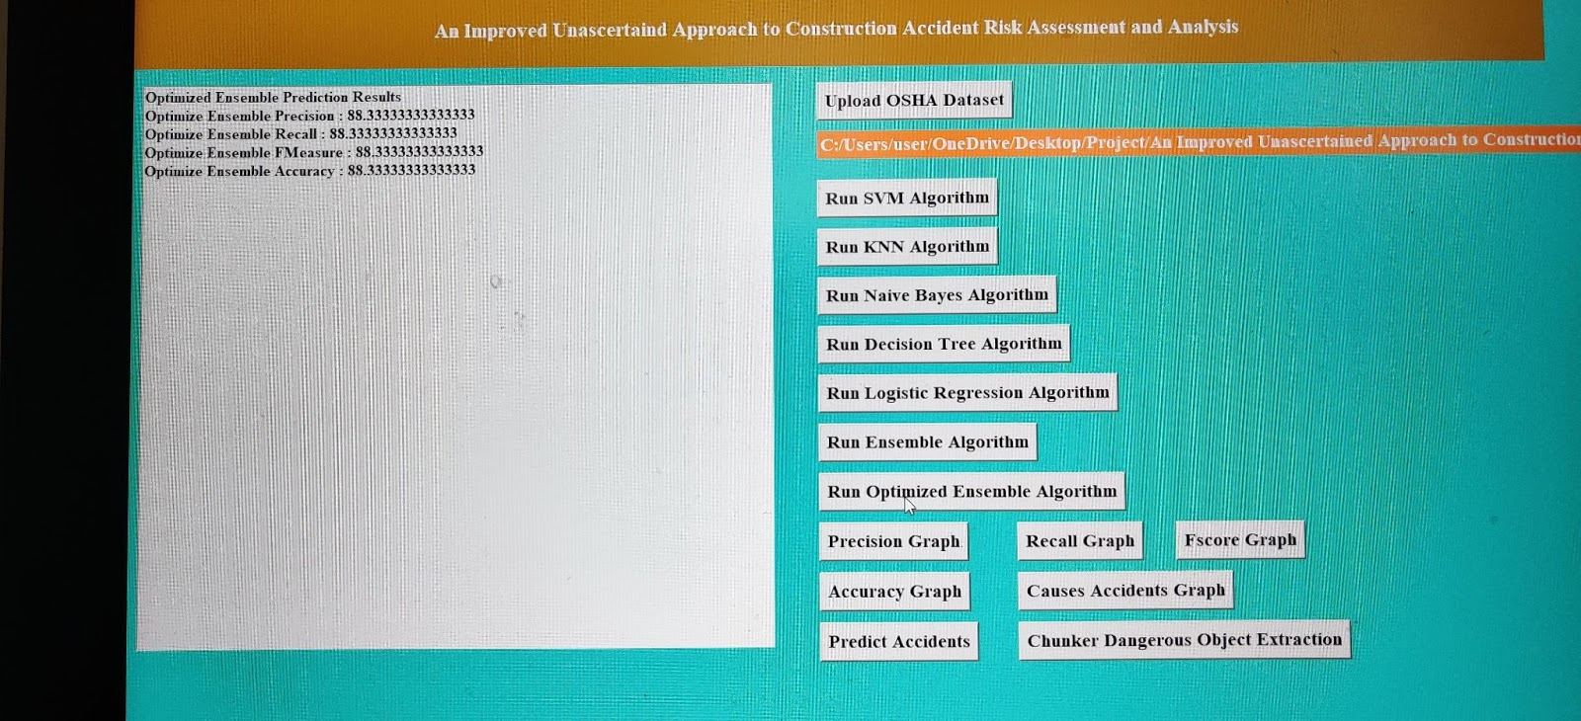
Result-1

Slide 8
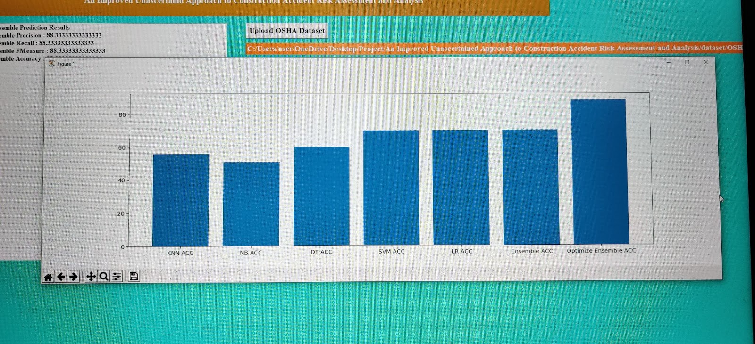
Result-2

Slide 9
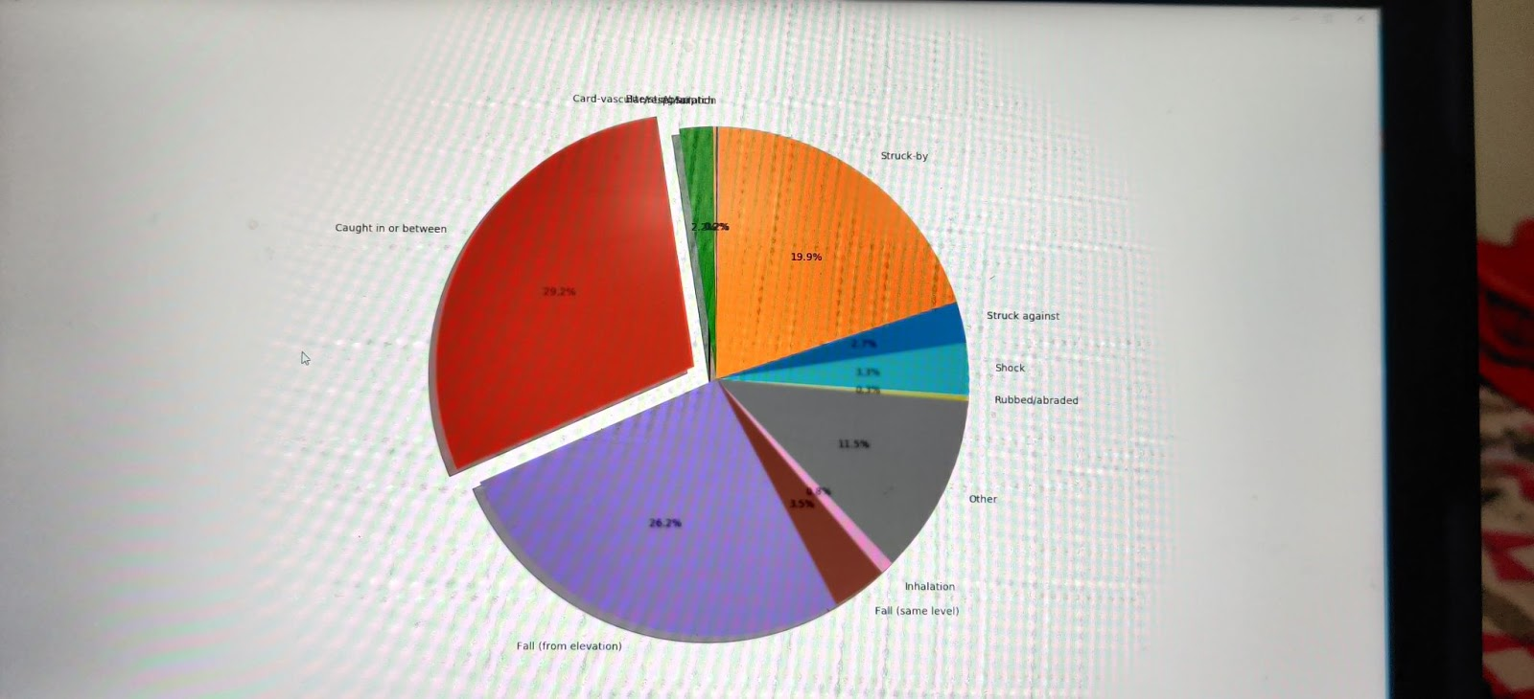
Result-3

Slide 10
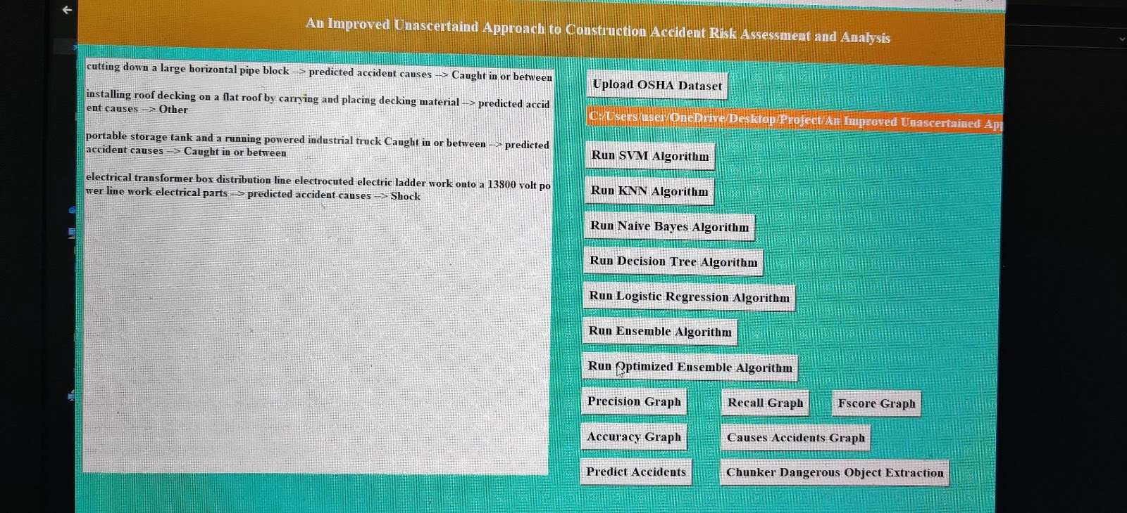
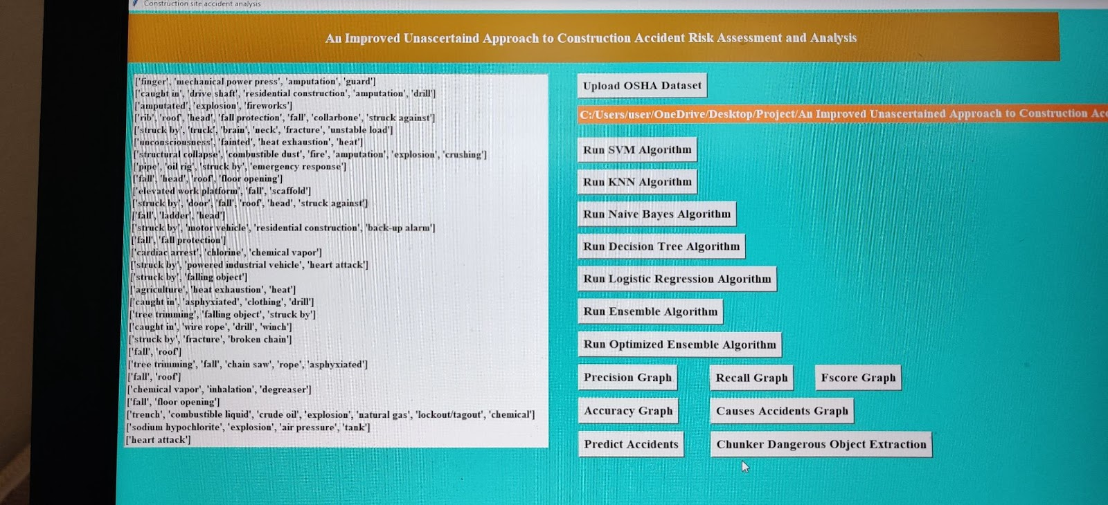
Result-4
Predicting Accidents and Object Extraction

Slide 11
Base paper link
https://drive.google.com/file/d/1lmH8G95Z-T1rS-mSi2ROUyTjDs_golRn/view?usp=sharing

Slide 12
Execution video Link
https://drive.google.com/file/d/12peiUe4-oRNwvvAr6lQwFDrVM5zb6l8v/view?usp=gmail

Slide 13
Thank You

